Slide 1

Arduino Based Home Automation Using TV Remote
Under Supervision of Prof. Hafizur Rahaman sir

Slide 2
Introduction:
. Arduino Uno is MCU, it fetch a data of humidity and temperature from DHT11 sensor and Process it and give it to a ESP8266 Module.
We can read a data from any sensor and analyse it graphically from anywhere in the world.
Using Internet of Things (IOT), we can control any electronic equipment in homes and industries
ESP8266 is a Wi-Fi module, it is one of the leading platform for Internet of Things. It can transfer a data to IOT cloud.

Slide 3
Arduino Based Home Automation
*Arduino based Home Automation using TV Remote is a simple project,
where an old TV Remote is used to control different appliances
*In this project, a remote control is used to control (simply ON and OFF)
several appliances or devices, thus achieving a simple home automation
system.

Slide 4
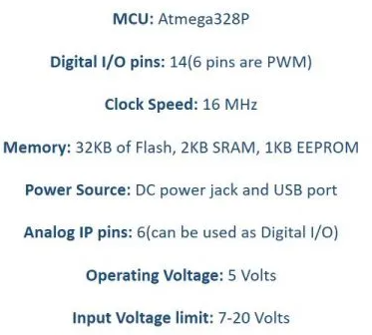
Arduino UNO:
The Arduino Uno is an open-source microcontroller board that is based on the Microchip ATmega328P (for Arduino UNO R3) or Microchip ATmega4809 (for Arduino UNO WIFI R2) micro-controller by Atmel and was the first USB powered board developed by Arduino.

Slide 5
Hardware Requirements:
DHT11
AMS1117-3.3V
9V battery
ESArduino Uno
P8266-01
Software Requirements
Arduino IDE

Slide 6
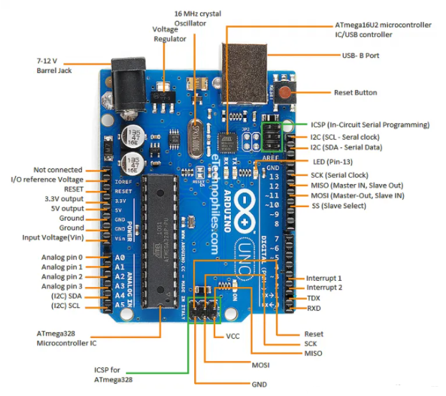
Arduino UNO Pin Configuration:

Slide 7
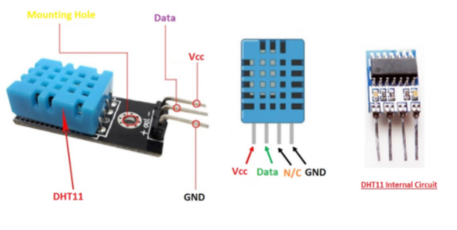
DHT11 Sensor:
The DHT11 is a basic, ultra low-cost digital temperature and humidity sensor. It uses a capacitive humidity sensor and a thermistor to measure the surrounding air and spits out a digital signal on the data pin (no analog input pins needed). It's fairly simple to use but requires careful timing to grab data.

Slide 8
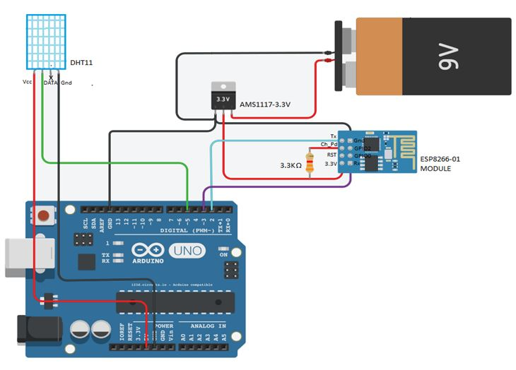
Circuit Diagram:

Slide 9
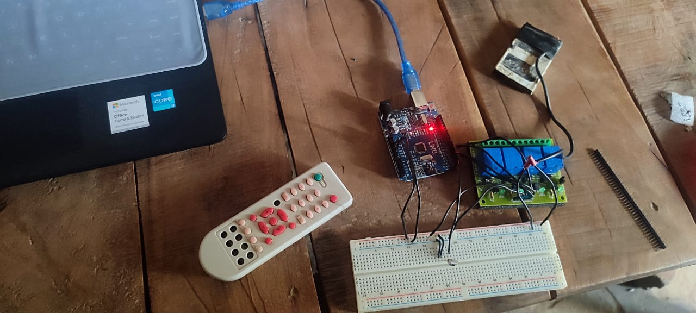
Making Of Model:-

Slide 10
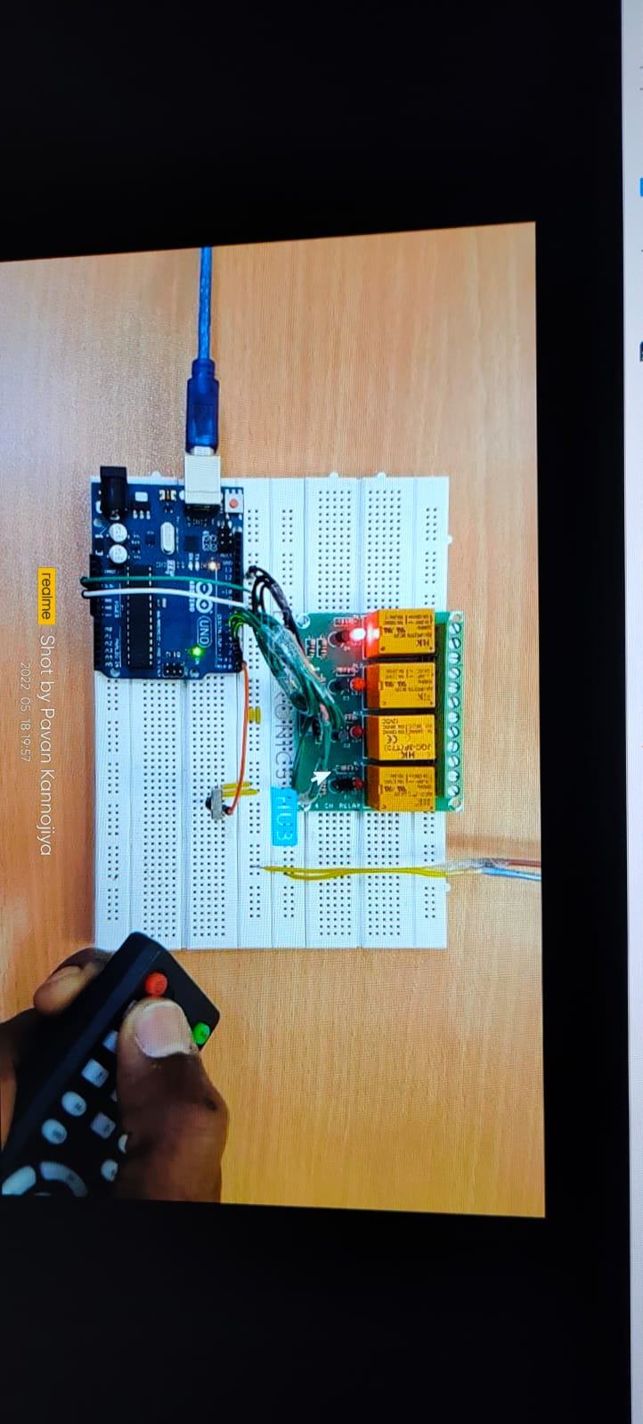
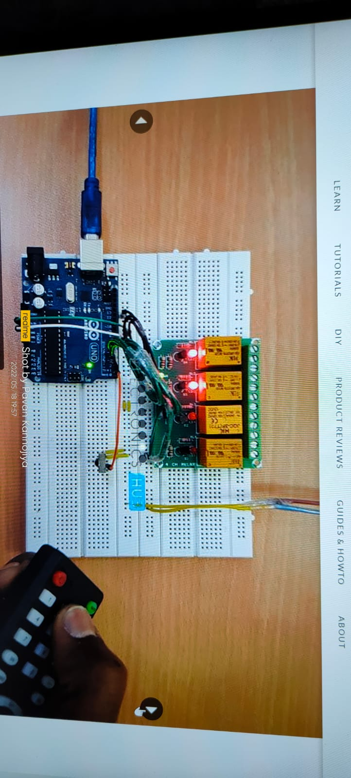
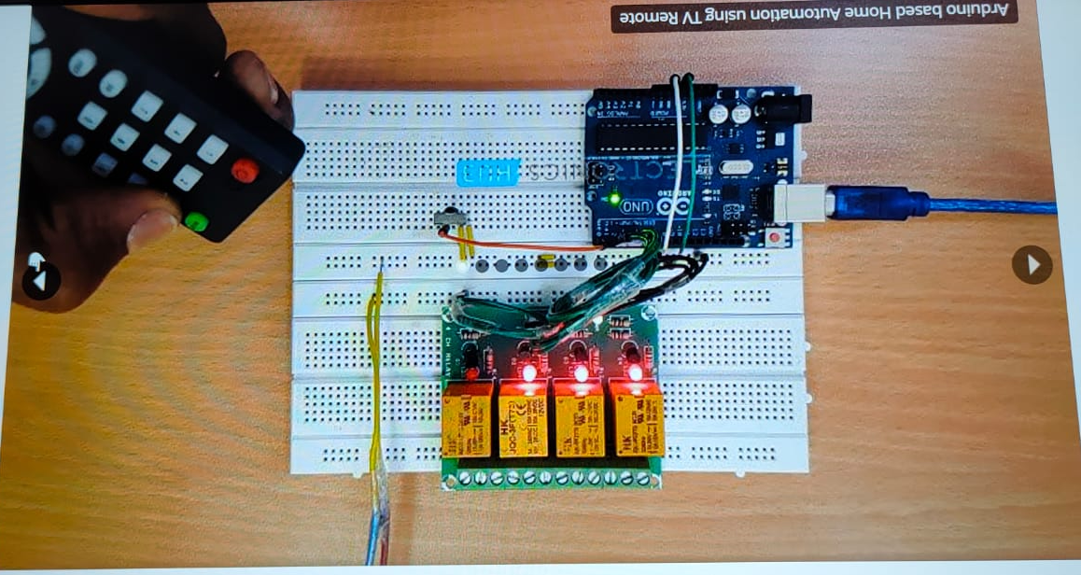
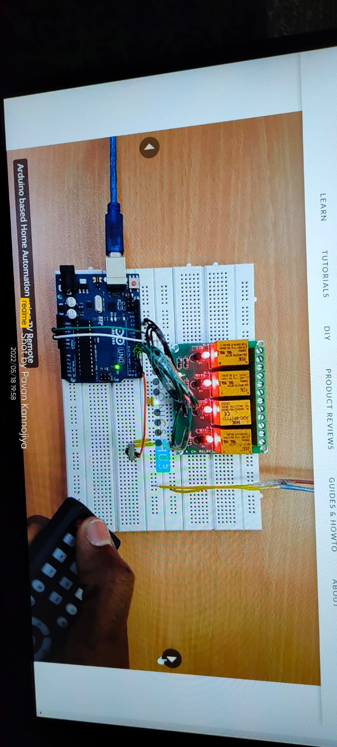
Result:-
*When We Press 1.
*When We Press 2.
*When We Press 3.
*When We Press 4.

Slide 11
Other Applications
We can also include a sensor like:-
Gas, infrared, ultrasonic sensors based on their requirements.
Moreover, it is possible to control the relay, actuators
through internet once a sensor values are going above/below
predetermined values.

Slide 12
Thank You
By:-
AADARSH KUAMR GUPTA
2020ITB046

